Slide 1
CONTAMINANTS??
Neurons
Use this to understand
how clusters were grouped
to identify good markers
Using C57B6_BBN samples.
Similar, strategy can be used to
identify contaminants
understand lineage
Likely a mixture of multiple cell types or rare cell types like neurons, etc..
MDSC (Myeloid Derived suppressor cells)
MYELOID (Macrophages, Dendritic cells
IMMUNE
LYMPHOID (B, T, NK cells)
Mix of lymphoid & myeloid cells
(close to myeloid cluster in UMAP but clustered with lymphoid cells in heatmap)
EPITHELIAL
NON-IMMUNE
FIBROBLASTS
ENDOTHELIAL
FIBROBLASTS (likely myofibroblasts as they are clustered with myocytes (cluster 36)

Slide 2
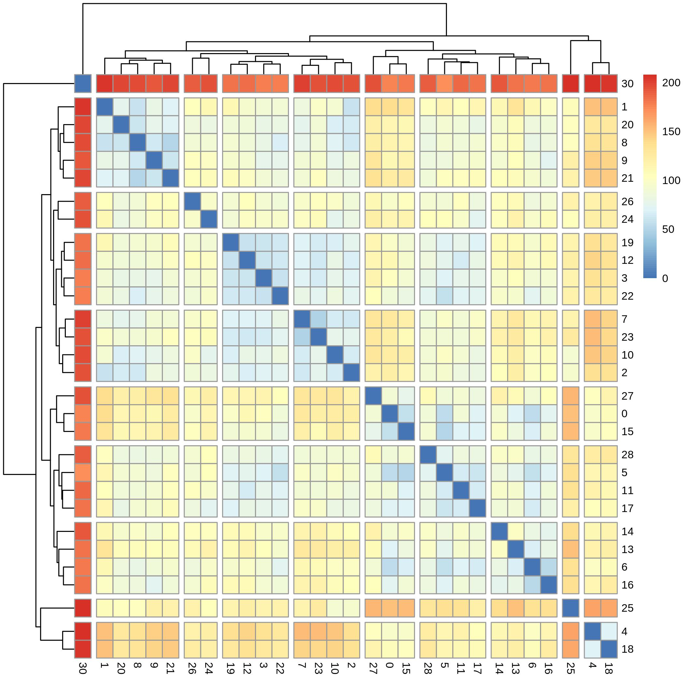
??
Type 1
??
Type 2
Type 3
Type 4
Type 5
Type 6
??
Type 7
Type 8
Type 9
Type 10

